Slide 1
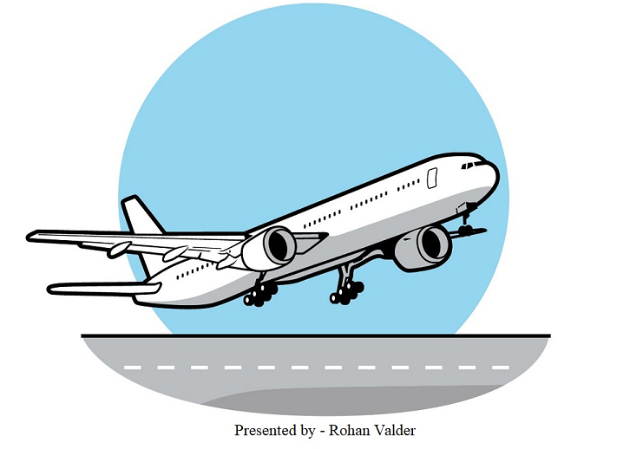

Valder Airlines

Slide 2


Car Vs Flight in US
Training
Fatalities

Slide 3
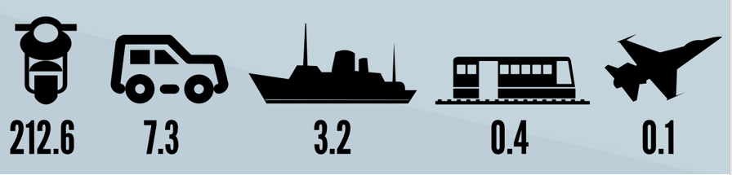
Deaths by travel
(one billion passenger miles)

Slide 4
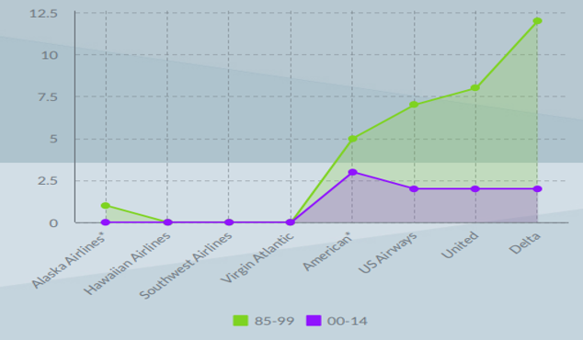
Fatal accidents in the us

Slide 5
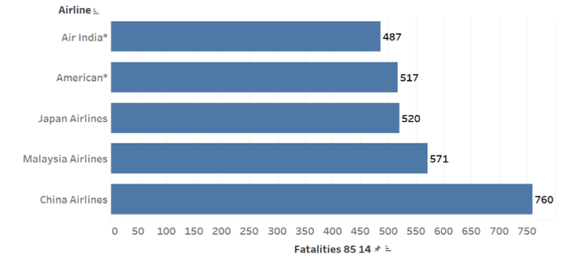
Total fatalities

Slide 6
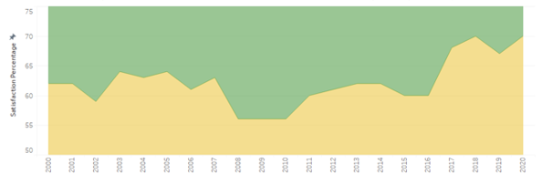
US Flights Customer Satisfaction Percentage

Slide 7
Conclusion
The comparisons are primarily with the US flights as Valder Airlines will be able to make better decisions
Based on histories such as fatalities and incidents, the airline industry is doing good now
Regarding safety, it proves by training and number of fatalities; airlines are the best
Hence airline travel is the preferred one and is excellent in the US

